Slide 1


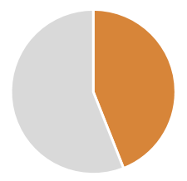





SOME MATHS
Achieving the SDGs requires business involvement and, in fact, represents a business opportunity.
Companies struggle to attract and retain talent
AND
Cost per leaver £30,000
Annual cost to the UK economy £4.1b
(The Telegraph, 2014)
BUT
Millenials are 5x more likely to stay at a company which has clear purpose and positive social impact
5
X
Currently 44% of millenials say they will leave their company within the next 2 years
WTF
Notes:
"in the UK the average cost to replace a departing staff member is £30,614 costing the British economy alone £4.13bn each year'
Staff turnover costs British businesses at least £4.13bn every year as new employees take up to eight months to reach optimum productivity levels, according to research released today.
The average fee for replacing a departing staff member is £30,614, says Oxford Economics and income protection providers Unum. This figure comprises two typical amounts – £5,433 for logistics, such as agency fees and advertising, and wages during the time when a new employee is yet to reach optimum productivity level, believed to be an average of 28 weeks at a cost of £25,182.
(The Telegraph, 2014)

